Slide 1


AGE 219: Object-Oriented
Programming (OOP)
Building Modular Models for Agricultural Engineering
Dr. Kadeghe Fue, PhD, P.Eng (T)
AI & Robotics Specialist | Office: EPAL | SoET SUA

Slide 2


Recap: Lecture 7 File Handling
We explored persistent storage, learning how to read and write sensor logs to CSV and TXT files for long-term season analysis.

Slide 3



Introduction to OOP Thinking
The Digital Mirror
Object-Oriented Programming (OOP) is a paradigm based on the concept of "objects," which can contain data and code.
Instead of just writing functions for math, we model physical things (Tractors, Sensors, Crops) as digital entities.

Slide 4
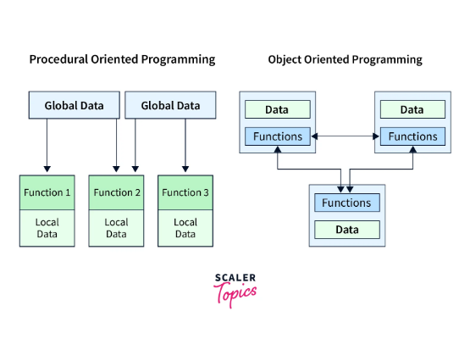
Procedural vs. Object-Oriented
Evolution of Logic
Procedural: Sequence of steps and functions. Focus on "What happens."
OOP: Interaction of autonomous units. Focus on "Who/What is it."
OOP is the foundation of modern AI and Robotics systems at SoET.

Slide 5

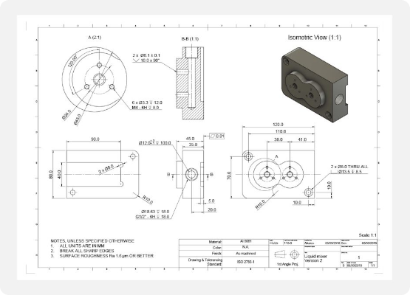
Classes: The Software Blueprint
Defining the Pattern
A Class is a blueprint or template for creating objects.
It defines what data the object will hold (attributes) and what actions it can perform (methods).
Example: The "Tractor" class defines that all tractors have an Engine and can Drive.

Slide 6
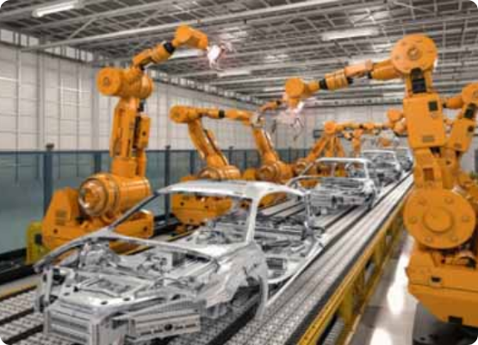
Objects: Realizing the Model
Individual Units
An Object (or Instance) is a specific realization of a class.
If "Tractor" is the class, then "Tractor-01" in the North Field is the Object.
Each object has its own unique values (e.g., Tractor-01 is at 50% fuel, while Tractor-02 is at 100%).

Slide 7


Defining Classes in Python
Creating Your Own Custom Data Types

Slide 8




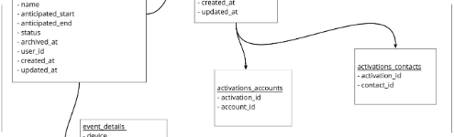
Class Syntax and Structure
Standard Definition
Visual Organization
Classes use the class keyword followed by a name in PascalCase.
Class bodies contain functions (methods) and variables (attributes).

Slide 9
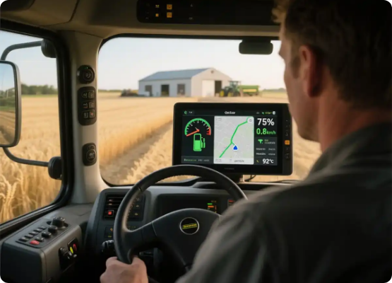
Attributes: Object State
Storing State
Attributes are variables that belong to an object.
For an automated tractor, attributes might include:
fuel_level
current_gps
engine_id

Slide 10


The __init__ Method
The Constructor
This special method runs automatically when an object is created. It initializes the object's attributes.

Slide 11


The self Parameter
Identifying the Instance
The first parameter of any class method must be self.
It acts as a placeholder for the "current instance." It allows the object to refer to its own data.

Slide 12
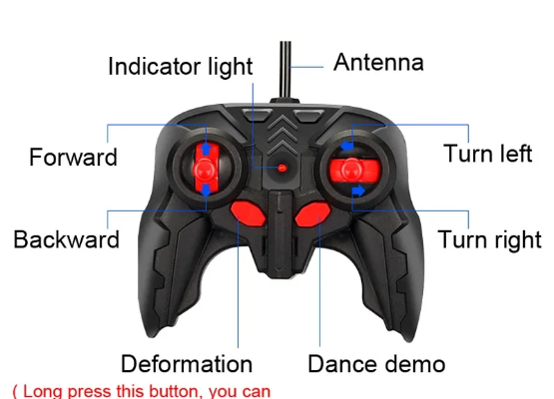

Methods: System Behavior
Defining Actions
Methods are functions defined inside a class that operate on the object's data.
Calling it: my_drone.spray()

Slide 13
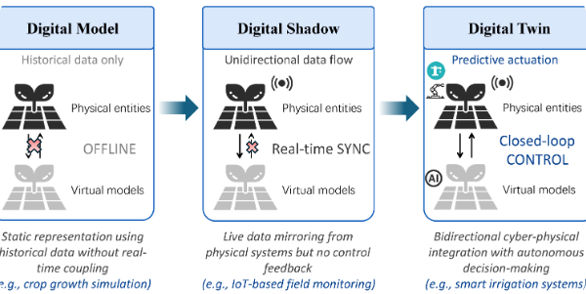
OOP in Engineering
Bridging Code and Machinery

Slide 14



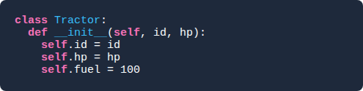


Case Study: The Tractor Class
The Model
Usage
We create a reusable model for any machine in the SoET fleet.
Instantiating multiple units:

Slide 15
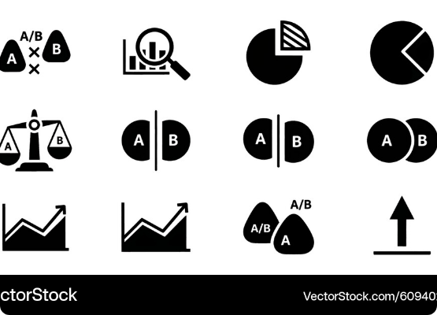
Instance vs Class Variables
Hierarchy of Data
Instance: Unique to each object (e.g., fuel level).
Class: Shared by all objects (e.g., factory location).

Slide 16
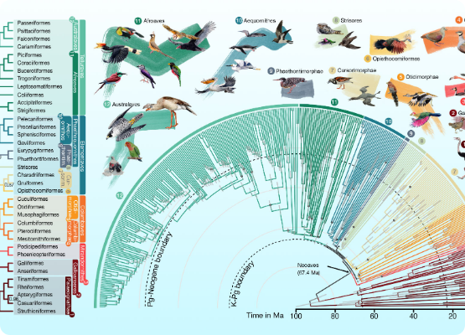
Inheritance: Code Reuse
The Machinery Family Tree
Inheritance allows a new class (child) to inherit the attributes and methods of an existing class (parent).
This represents the IS-A relationship. A "Combine Harvester" is-a "Machine."

Slide 17
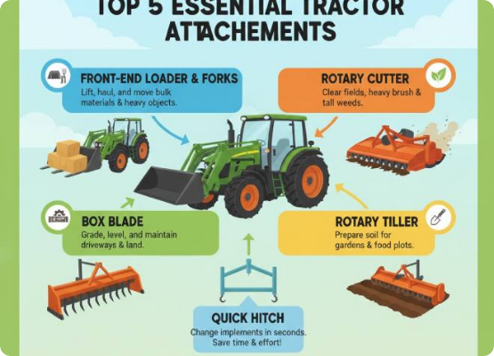

Creating Subclasses
Specialized Logic
Subclasses add unique features while keeping core functions.
The Sprayer can drive (inherited) AND toggle booms (unique).

Slide 18
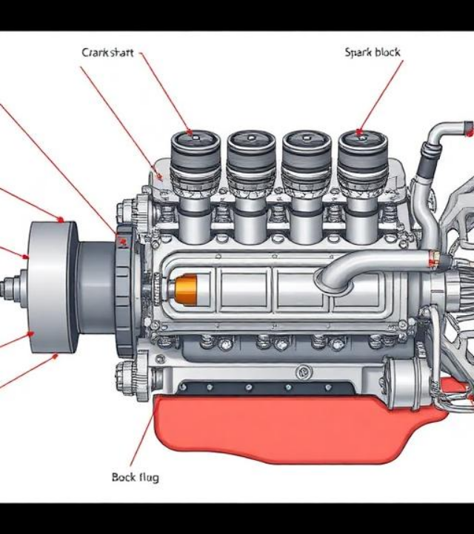
The super() Function
Parental Guidance
The super() function allows the child class to call methods from the parent class.
Crucial when the child class needs to extend the behavior of the parent's __init__ method.

Slide 19

Encapsulation: Protection
Information Hiding
Protecting internal data from outside interference.
In Python, we use underscores to suggest "Private" status.
_private_variable
Prevents a script from accidentally setting fuel to -500.

Slide 20


Polymorphism: Flex Logic
"Many Forms"
Polymorphism allows different classes to have methods with the same name but different behaviors.
A Drone's move() involves flying, while a Tractor's move() involves rolling. The command is the same; the logic differs.

Slide 21

Abstract Classes in AI
Generic Controllers
In high-level robotics, we create Abstract Base Classes to define standard interfaces for all hardware controllers.
This ensures any new robotic attachment will "plug-and-play" with our core AI logic.

Slide 22



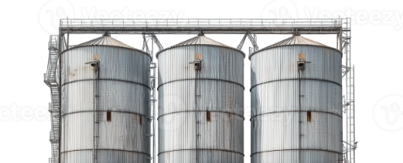

Practical: Smart Silo Model
The Task
Simulation context
Model a Grain Silo system.
Create a class with a calculate_mass() method.
Students will implement this in the Colab lab session.

Slide 23










Summary: Pillars of OOP
Encapsulation
Inheritance
Polymorphism
Abstraction

Slide 24


Questions?
Thank you for your attention.
Next Lecture: Data Analytics & Scientific Plotting
School of Engineering and Technology (SoET) | SUA Morogoro

